Slide 1
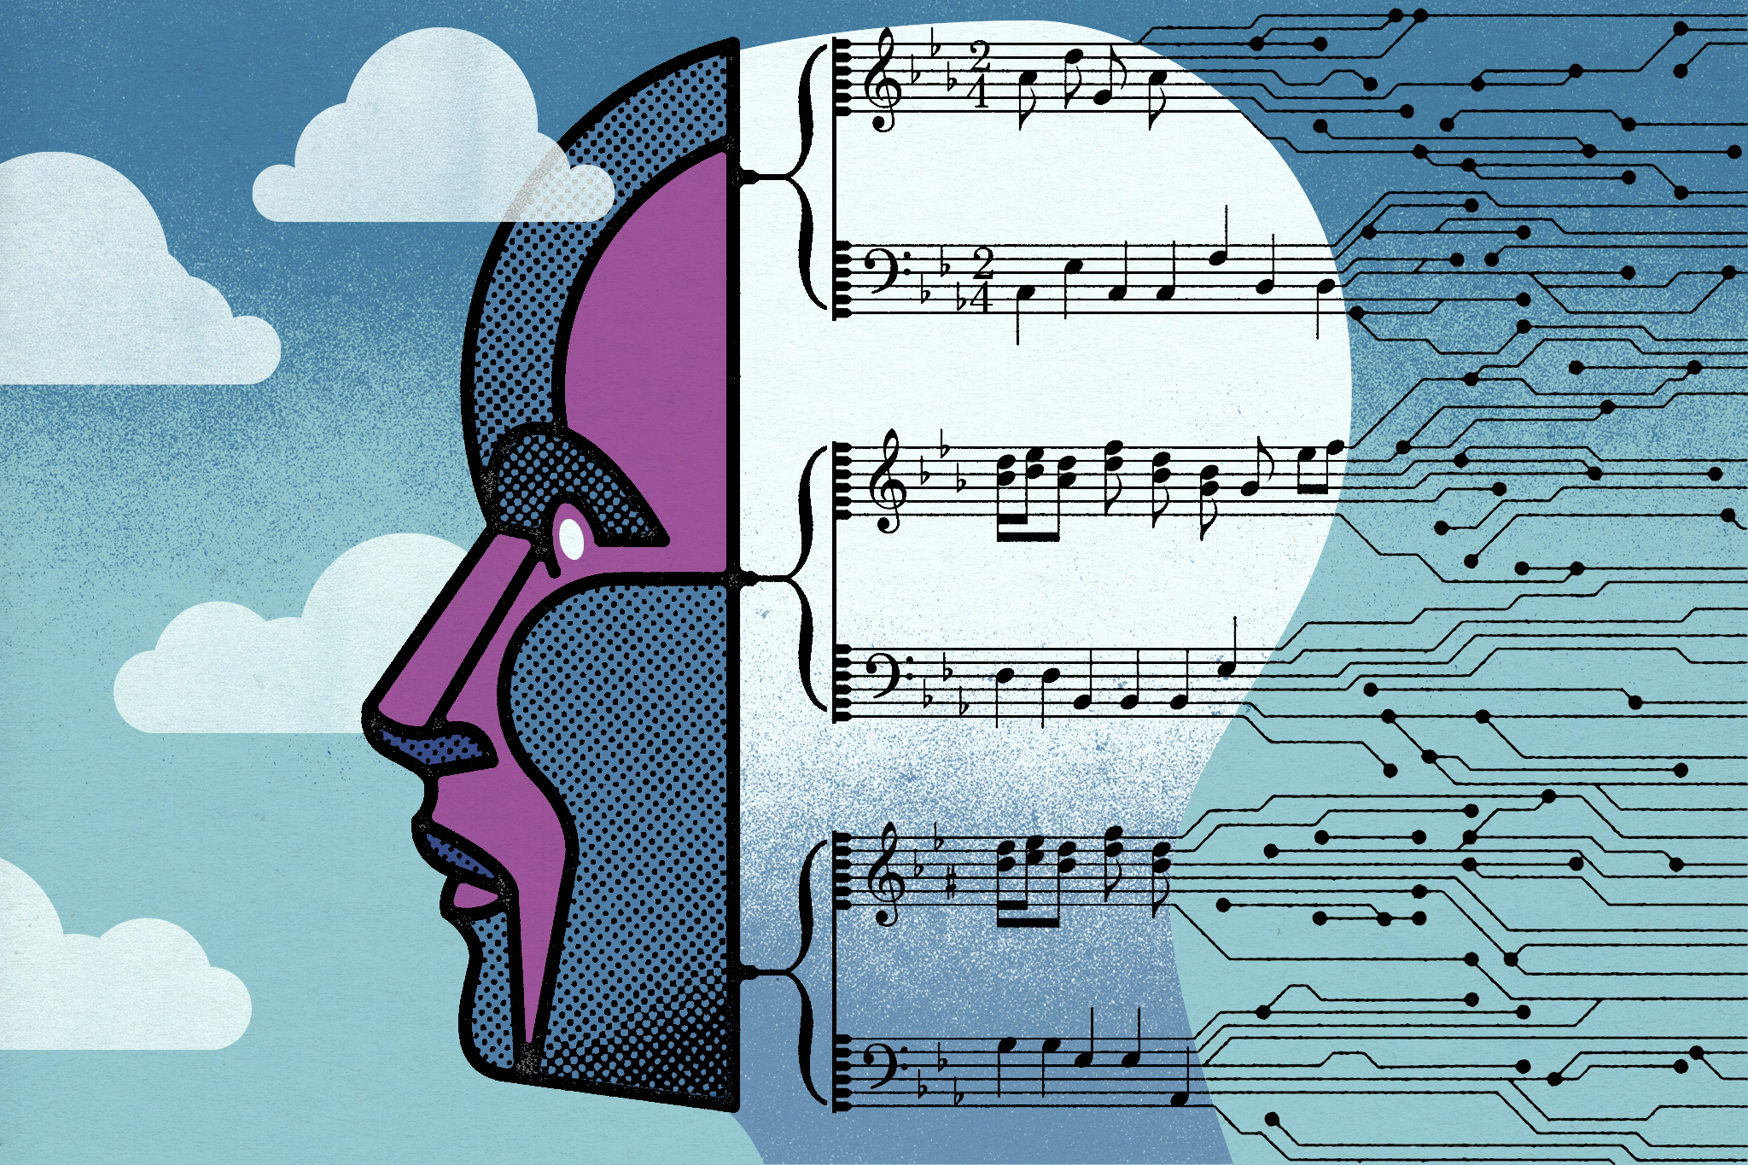

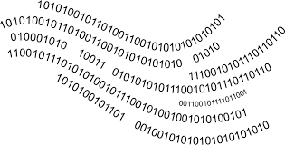
AI-Driven Music Caption Generation using LLM “Music in Human Terms”
By Bhuvanendra Putchala
Sneha Sasanapuri
Notes:
"I’m Sneha, and I’m excited to share our project, which I worked along my teammate, Bhuvan. Our project is called AI-Driven Music Caption Generation using Large Language Models, and it explores an exciting area of multimedia processing.
As you know, multimedia processing has become increasingly important, especially with applications like accessibility, media analysis, and content generation.
One fascinating task in this domain is audio captioning—basically turning sounds and music into meaningful text descriptions. We tackled this by building a cloud-based system for audio captioning that combines AWS services for automation and scalability.
Let’s dive in!"

Slide 2
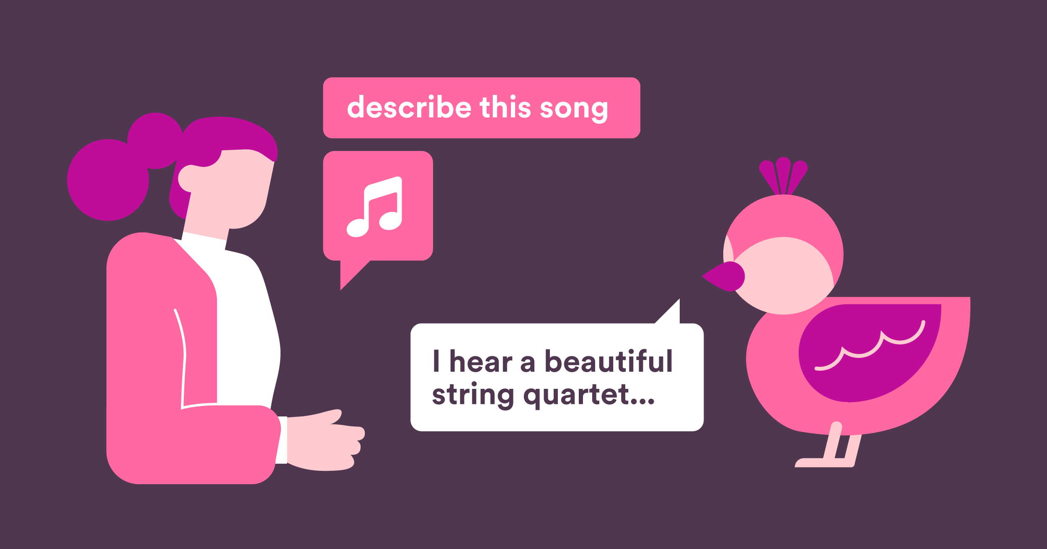

Context
Understand the essence of an unfamiliar audio clip
Identify attributes like mood, instrumentation, or style
Useful for music recommendation platforms
Bridges gap by enabling machines to "describe music in human terms"
Notes:
Before moving on, I just wanna set the context and motivation behind taking up this project.
There are primarily two reasons why we chose this project is:
1. While multimedia processing has seen significant advancements, there's one area that still has relatively less exploration compared to image processing—and that's audio processing. Think about it: we’ve seen groundbreaking developments in image captioning, but when it comes to audio, the availability of structured datasets and refined models is quite limited.
2. For instance, identifying if a track is upbeat or melancholic, what instruments are playing, or the style of music. By enabling machines to describe music in human-like terms, we bridge the cognitive gap between audio data and human understanding. This is particularly useful for music recommendation platforms.

Slide 3
Goals
Captioning
Summary Generation
OpenAI's text generation API to summarize the chunk-wise audio captions into a cohesive, high-level summary
Scalable solution
End-to-end workflow using AWS services
Automate audio captioning in real-time for music clips Deploy machine learning model
Capturing key themes, emotional tones & insights from audio content
Amazon SageMaker and other AWS tools (EBS, lambda, Code build), Docker to enable scalable and efficient processing of audio data
Notes:
Our primary goal is to develop a scalable and efficient system capable of processing audio files and generating captions that describe the music’s mood, style, and instrumentation. These generated captions are then summarized to bring meaningful insights. To achieve this, we have leveraged advanced machine learning techniques, AWS infrastructure for deployment.

Slide 4
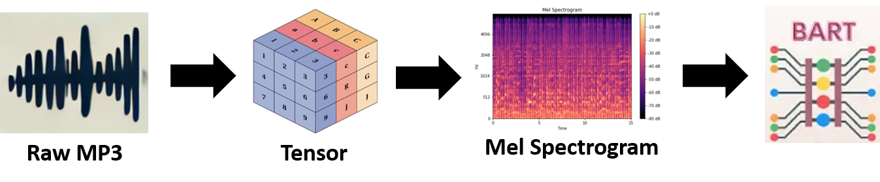
Components
Backend Cloud Infra
Elastic Bean Stalk
Lambda functions
Model
BART
Open AI
S3 Buckets
Sage Maker
S3 Events Notification
Cloud Watch
Hugging Face
Code Build
Front end
Flask
Java
Html
Notes:
We have categorised components into 3 broad areas.
Front end
Backend Cloud Innfrastructure, AWS in our case
Deep learning model
To host our webpage, we deployed FLASK server in backend and for styling and visual appearance, we utilised Java and HTML.
We have explored multiple components in AWS like EBS, lambda, Sagemaker and we will see the workflow and architecture in next slide in depth.
Coming to model part, we have embedded learned parameters and architecture from Hugging Face.
The raw MP3 files gets converted into numerical tensors. FFmpeg is used for resampled and converting into mel spectrograms, which are visual representations of the time-frequency features of the sound.
Next, the AudioEncoder processes these mel spectrograms using a series of convolutional layers, extracting critical audio features and enhancing them with positional embeddings, which are then fed into a pre-trained BART model, which generates natural language captions that describe the audio content chunk wise.

Slide 5
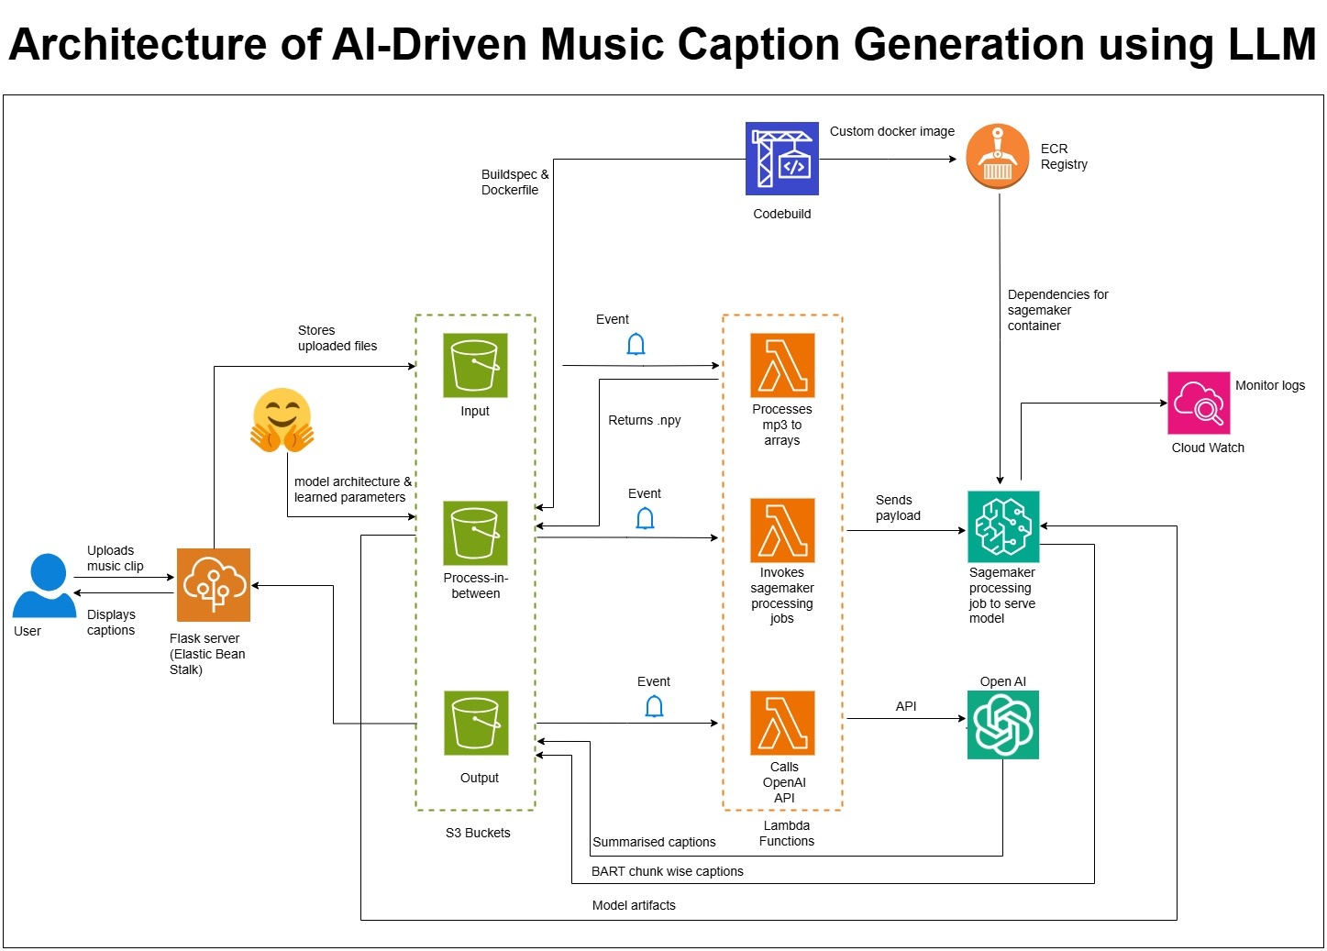
Architecture
Notes:
1. When a user uploads mp3 file on our webpage hosted on ElasticBeanStalk, it stores the file in an S3 bucket.
2. This upload event triggers a Lambda function that converts the .mp3 file into .npy format and stores the processed file in a second S3 bucket.
3. Again, This insertion of the .npy file triggers another Lambda function, which in turn invokes Sagemaker processing job for inference.
4. This processing job loads model from S3 bucket and generate chunk wise captions and stores it to output bucket.
5. We have opted to store and pass these chunk wise captions to enhance quality of captions ensuring that all details are captured.
6. These chunk wise captions are then passed onto lambda function through event notification which makes a call to OPEN AI API for summarization and stores in output bucket.
7. All this whole process may take a while depending on how long the uploaded audio clip is. So, we have adjusted our webpage to poll for every 10 seconds till it gets output. The number of attempts which you will be seeing in our demo video is the maximum number of polls.
8. Once a poll is successful, this summary is then displayed to user.
Let’s see the live demo now!

Slide 6
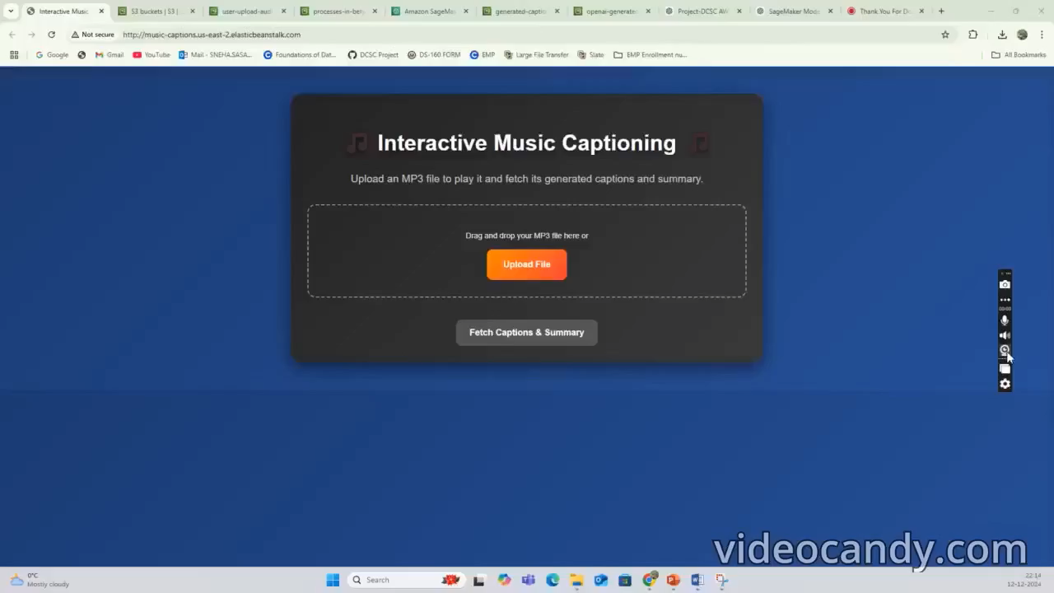
Demonstration

Slide 7




Debugging
Cloud Watch Logs
Launching a container in EC2 instance for live testing
Interactive terminal Mode overriding entry point
Port forwarding
Simulating Sage Maker behavior
Custom image with required dependencies
Created dummy test cases
Check API responses
Payload to-and-fro
Notes:
We encountered several issues, such as:
Cloud Watch logs helped really a lot in understanding where the error was and what it is about.
But for some services, especially like Sagemaker job, the logs were not informative enough to debug. So, we attempted trying on our PC first, but this in turn posed many other challenges like mismatch in amd64 Vs arm64 architectures, schema version mismatch b/w images. So, we again launched container in EC2 instance and entered into terminal mode for better debugging.
I can say Sagemaker was the most challenging part, which took almost 50% of our project time. Sagemaker container instance has some in-built things and we faced problems with container initialization and health checks. These were resolved by replicating those things in our container to simulate sagemaker behaviour.
We also created small and dummy test cases to test whether server is responding or not and to see a particular type of payload is readable or not.
Each of these challenges taught us the importance of testing components in isolation before integrating them.

Slide 8
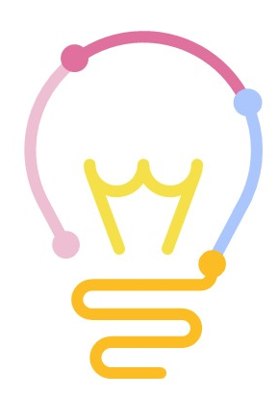
Learning Outcomes
Learned about spectrograms, Mel encoders, and audio-to-text models
Digital signal processing of signal by SFT
Made our hands dirty on deploying machine learning models on AWS Sage Maker
Managed large-scale model artifacts and ensured efficient storage and retrieval from S3
Dependency conflicts, circular imports, architecture mismatches
Notes:
I can say this project offered several technical and non-technical learning opportunities:
Technical learnings:
We mastered audio preprocessing using tools like librosa and ffmpeg to generate Mel spectrograms.
We learned to fine-tune a complex model by integrating audio encoders with large language models.
Deploying the model on AWS SageMaker provided hands-on experience with cloud-based ML workflows.
Non-technical learnings:
Effective communication and teamwork were crucial during debugging sessions.
We improved our ability to troubleshoot by systematically isolating issues and iterating on solutions. Overall, this project helped us bridge the gap between theoretical knowledge and practical implementation."

Slide 9
Improvements
Implement Sage Maker endpoint to avoid re-loading model
Integration with music platforms (Ex: Spotify)
Generate next piece of music
Notes:
While we achieved significant milestones, there’s always room for improvement:
Improving inference efficiency: Transitioning from SageMaker processing jobs to endpoints could make the system faster and more responsive.
Enhancing model outputs: The current captions are highly descriptive but could benefit from adding musical insights like genre evolution or related tracks.
Extending use cases: Integrating this system with platforms like Spotify or YouTube could make it directly impactful for end users, whether for music discovery or accessibility. These enhancements would make the solution even more robust and user-friendly."

Slide 10
Thank You!!

